Slide 1
college physics
UVU Summer 2010 Rm. 202
MTWT 11am-12:50pm
Instructor Tim Wendler

Slide 2
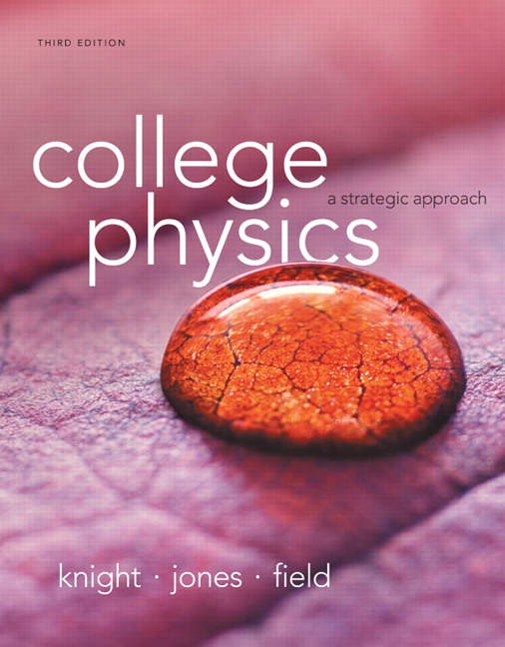
The Textbook
“college physics: a strategic approach” third edition, Knight, Jones, Field
We will cover the first 16 chapters
Accelerated Motion , Circular Motion, Harmonic Motion
Vectors and Forces
Gravity
Momentum, Energy, and Work
Thermal Properties of Matter
Fluids and Waves

Slide 3
Grading
50% Homework
This grade will come directly from MasteringPhysics.com
30% In-class quizzes QQ
Each day, questions will be asked throughout the lecture
The question will be over what was taught minutes earlier
10% Midterm
10% Final

Slide 4
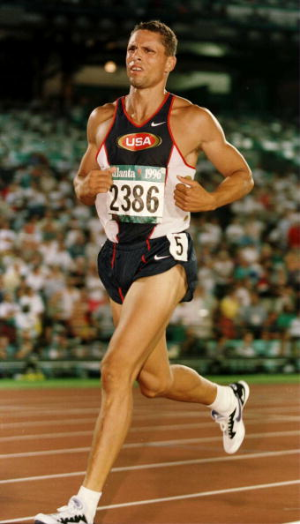
Let’s warm up

Slide 5
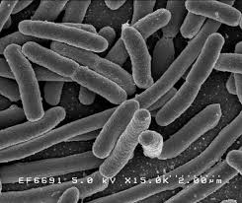
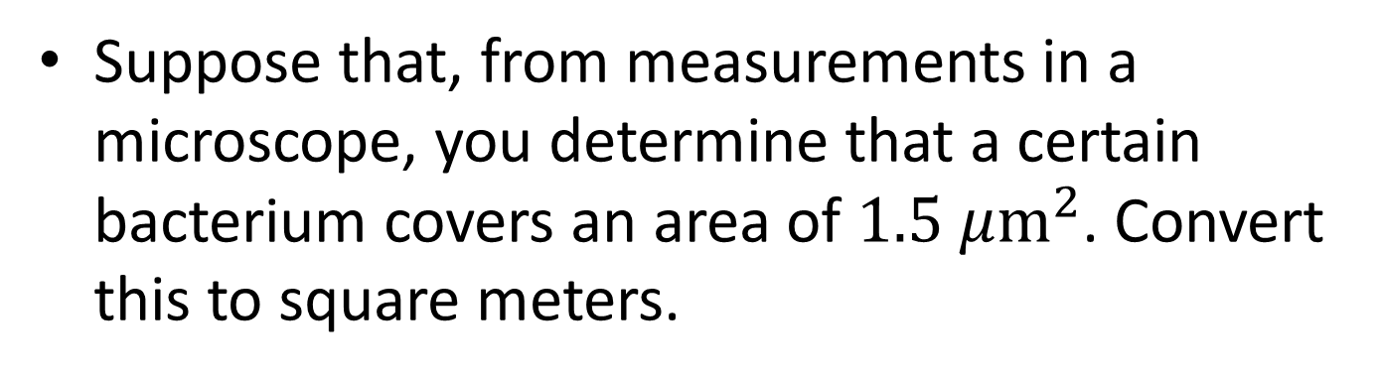
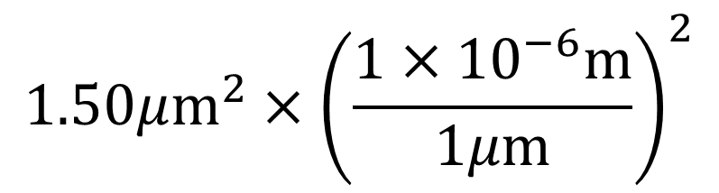
Suppose that, from measurements in a microscope, you determine that a certain bacterium covers an area of $1.5 μ{\text{m}}^{2}$. Convert this to square meters.
$$1.50μ{\text{m}}^{2}×{\left(\frac{1×{10}^{−6}\text{m}}{1μ\text{m}}\right)}^{2}$$
$1.50×\left(1×{10}^{−6×2}{\text{m}}^{2}\right)→$ $1.5×{10}^{−12}{\text{m}}^{2}$

Slide 6
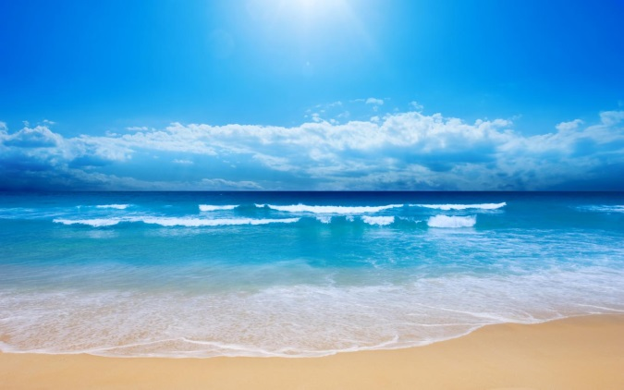

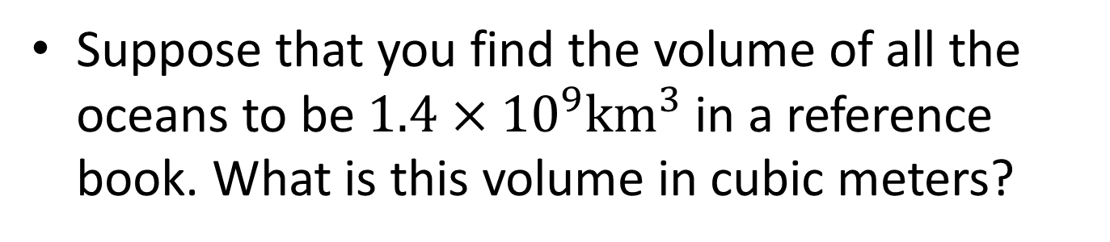
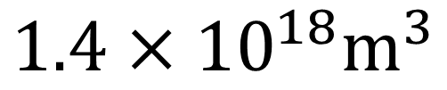
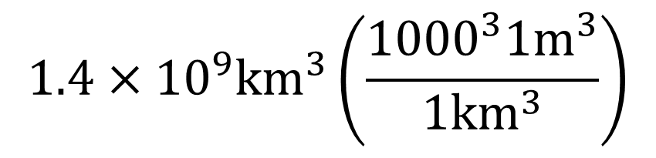
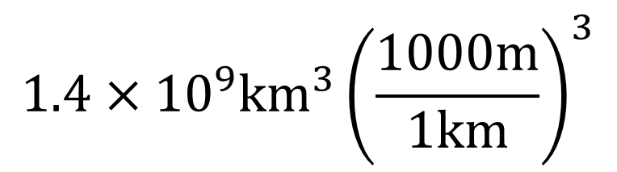
Suppose that you find the volume of all the oceans to be ${1.4×10}^{9}{\text{km}}^{3}$ in a reference book. What is this volume in cubic meters?
$${1.4×10}^{9}{\text{km}}^{3}{\left(\frac{1000\text{m}}{1\text{km}}\right)}^{3}$$
$${1.4×10}^{9}{\text{km}}^{3}\left(\frac{{1000}^{3}1{\text{m}}^{3}}{{\text{1}\text{km}}^{3}}\right)$$
$${1000}^{3}→1×{10}^{9}$$
$${1.4×10}^{18}{\text{m}}^{3}$$

Slide 7
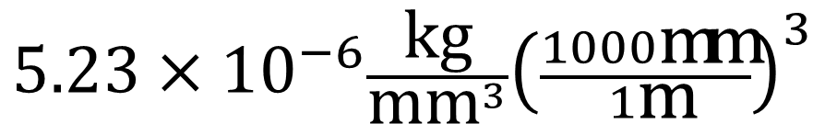
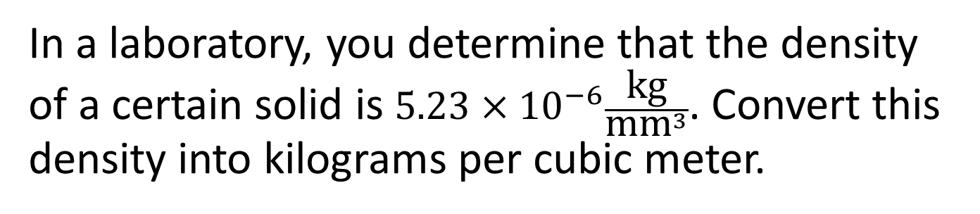
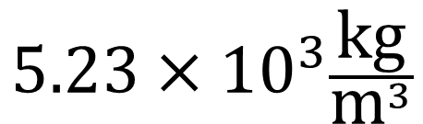
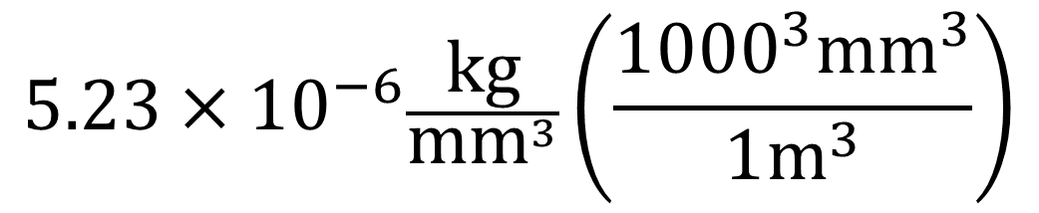
In a laboratory, you determine that the density of a certain solid is $5.23×{10}^{−6}\frac{\text{kg}}{{\text{mm}}^{3}}$. Convert this density into kilograms per cubic meter.
$$5.23×{10}^{−6}\frac{\text{kg}}{{\text{mm}}^{3}}{\left(\frac{1000\text{mm}}{1\text{m}}\right)}^{3}$$
$$5.23×{10}^{−6}\frac{\text{kg}}{{\text{mm}}^{3}}\left(\frac{{1000}^{3}{\text{mm}}^{3}}{1{\text{m}}^{3}}\right)$$
$$5.23×{10}^{3}\frac{\text{kg}}{{\text{m}}^{3}}$$

Slide 8

Let’s start the chapter 1 slides!

